Slide 1
Gas Detecting Alarm System
Presented by :
A. Srimanth
K.V.S.N. Ganesh
Girija prasad Acharya
M. Gnaneshwar

Slide 2
Introduction
This presentation covers a gas sensor project using Arduino UNO, including embedded systems, components, and coding basics.

Slide 3

Definition and Importance
Embedded systems are specialized computing systems that perform dedicated functions within larger mechanical or electrical systems. They are designed to execute specific tasks in real-time, often optimized for performance, reliability, and efficiency

Slide 4

Common Applications
Embedded systems are widely used in automotive, home appliances, healthcare, and industry, powering smart and automated functions reliably.

Slide 5
Project Overview
02

Slide 6

Overview of Gas Sensor Project
The main goal of this project is to design a gas detection system that alerts users through visual and auditory signals. With a user-friendly LCD interface, participants can easily monitor gas levels and respond to any detected hazards swiftly.

Slide 7
Working Mechanism
Our gas sensor detects specific gases and sends signals to the Arduino UNO, which processes this information and displays it on an LCD. If gas levels exceed safe limits, an LED light will alert users, and a buzzer will sound an alarm.

Slide 8
Components Explanation
03

Slide 9

LCD (16x2) Usage
The 16x2 LCD clearly displays gas levels and system status. It's simple to connect with an Arduino, making it easy for users to monitor safety in real time and take quick action if needed.
The pin configuration is given as:
1 — VSS: Ground (0V) 2 — VDD: +5V power supply 3 — V0: Contrast adjustment (connect to potentiometer) 4 — RS: Register Select (0 = Command, 1 = Data) 5 — RW: Read/Write (0 = Write, 1 = Read) 6 — E (Enable): Activates the LCD when toggled 7 to 14 — D0 to D7: Data pins (use D4 to D7 for 4-bit mode) 15 — LED+ (A): Backlight anode (+5V) 16 — LED− (K): Backlight cathode (GND)

Slide 10

Gas Sensor Functionality
The gas sensor detects the presence of specific gases such as methane or propane. Once it identifies unsafe gas concentrations, it sends alerts through the Arduino, making it a critical component of the safety system.
Types of gas sensors :
MQ 2, MQ 4, MP 2, MQ 5, MQ 6, MQ 7…etc
Here in this project we used is MQ 2.

Slide 11

Arduino UNO Features
The Arduino UNO is a v microcontroller board that’s perfect for beginners and experts alike. It features digital and analog inputs/outputs, USB connectivity for easy programming, and an intuitive interface, making it a great choice for projects like our gas sensor setup.

Slide 12
LED Indicators and Buzzer Functions
LED indicators are the operational status of the system. Different colors (green for normal, red for alert) signify system states, allowing users to quickly understand the status of gas levels without needing to look at the LCD.
The buzzer functions as an auditory alert system that sounds alarms when gas levels exceed safe thresholds

Slide 13
Tinkercad Simulation
04

Slide 14

Benefits of Simulation
Tinkercad provides an easy way to simulate the gas sensor project, showing component interactions and setup functionality without physical hardware, ideal for testing and prototyping.
Using Tinkercad simulation helps catch design issues early, saves material costs, and prepares you for building the actual circuit smoothly.

Slide 15
Circuit Design
05

Slide 16
Basic Layout
The circuit layout is straightforward, using the Arduino to connect components like the gas sensor, LCD, and buzzer with two leds and two bread boards . A clear layout will help in understanding the flow of signals and ensure everything works seamlessly.

Slide 17
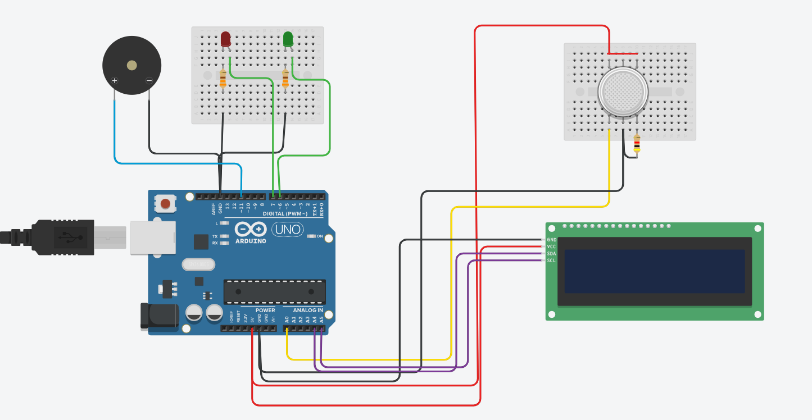

Slide 18
Code Overview
06

Slide 19
// C++ code #include <Adafruit_LiquidCrystal.h> int gassensor = 0; Adafruit_LiquidCrystal lcd_1(0); void setup() { pinMode(A0, INPUT); Serial.begin(9600); lcd_1.begin(16, 2); pinMode(7, OUTPUT); pinMode(6, OUTPUT); pinMode(11, OUTPUT); }void loop() { gassensor = analogRead(A0); Serial.println(gassensor);
lcd_1.setCursor(0, 0);
lcd_1.print(gassensor);
if (gassensor >= 500) {
lcd_1.setCursor(0, 1);
lcd_1.print("Gas Detected");
digitalWrite(7, HIGH);
digitalWrite(6, LOW);
digitalWrite(11, HIGH);
} else {
lcd_1.setCursor(0, 1);
lcd_1.print("Gas is not Detected");
digitalWrite(7, LOW);
digitalWrite(6, HIGH);
digitalWrite(11, LOW);
}
delay(10); //Delay a little bit to improve simulation performance
}

Slide 20

Conclusions
The project successfully illustrates the integration of an Arduino-based gas sensor system utilizing various components. This setup not only provides real-time monitoring but also showcases the effectiveness of embedded systems in enhancing safety in various applications.

Slide 21
Thank you!🙏

